Slide 1
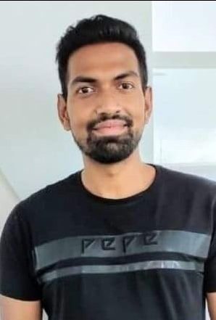
Know Your Mentor
My name is Saurabh Kandhway . I have around 10 years of Experience into QA Automation role . I am currently working as a Test Architect in one of the Leading MNCs .I have around 5+ years of teaching experience into all the tools and technologies used for testing .I have also worked as Onsite test analyst for 2 years in Melbourne Australia .I am ISTQB , AZ 900 Microsoft Azure Fundamentals, Pcloudy (Cloud based environment for Testing) certified testing professional . I am a certified Simplilearn high Engagement trainer.

